Slide 1

Data Visualization of Bird Strikes between 2000-2011

Slide 2
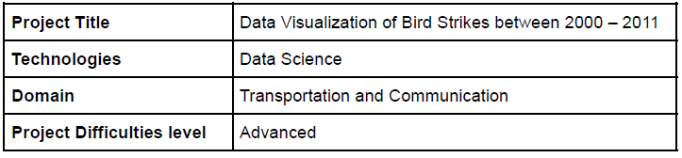
Project Detail

Slide 3
Background
Transport and communication are in the crucial domain in the field of analytics.
Environmental impacts and safety are, nowadays, two major concerns of the scientific
community with respect to transport scenarios and to the ever-growing urban areas.
These issues gain more importance due to the increasing amount of vehicles and
people. Seeking new solutions is reaching a point where available technologies and
artificial intelligence, especially MAS, are being recognized as ways to cope with and
tackle these kinds of problems in a distributed and more appropriate way.
A bird strike is strictly defined as a collision between a bird and an aircraft which is in
flight or on a take-off or landing roll. The term is often expanded to cover other wildlife
strikes - with bats or ground animals. Bird Strike is common and can be a significant
threat to aircraft safety.
Bird strikes may occur during any phase of flight, but are most likely during the
take-off, initial climb, approach and landing phases due to the greater numbers of birds
in flight at lower levels. To have a closer look the following document visually depicts
the data collected on Bird Strikes by FAA between 2000-2011.

Slide 4

Problem Statement
The goal of this project is to analyse the bird strike incidents happened between 2000-2011. To achieve the goal, we used a data set that is collected by FAA during 2000-2011. The objective of the project is to perform data visualization techniques to understand insights of the data. This project aims apply various Business Intelligence tools such as Tableau or Power BI to get a visual understanding of the data.

Slide 5
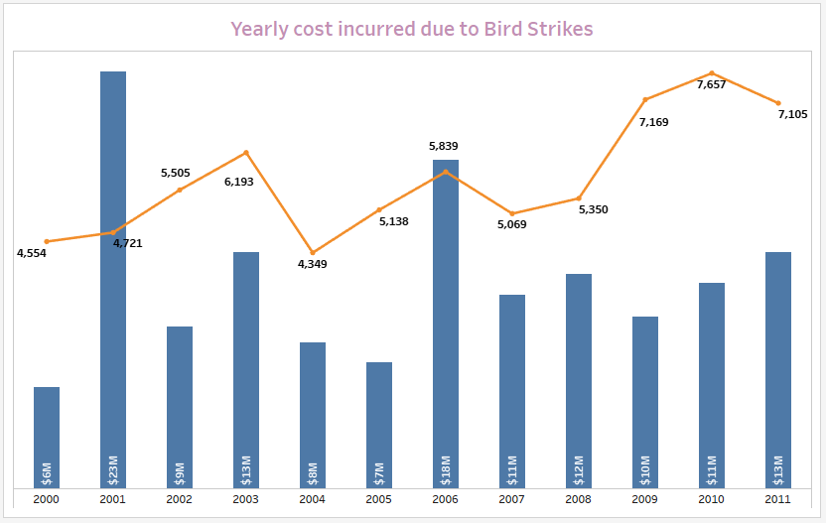
Insights

Slide 6
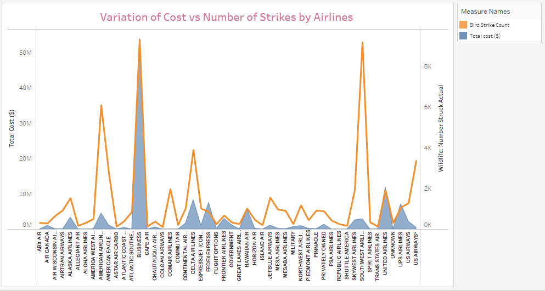
Variation of Cost vs Number of Strikes by Airlines

Slide 7
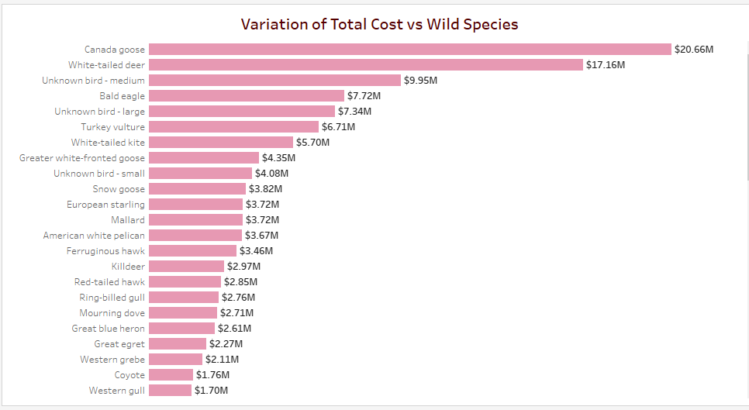
Variation of Total Cost vs Wild Species

Slide 8
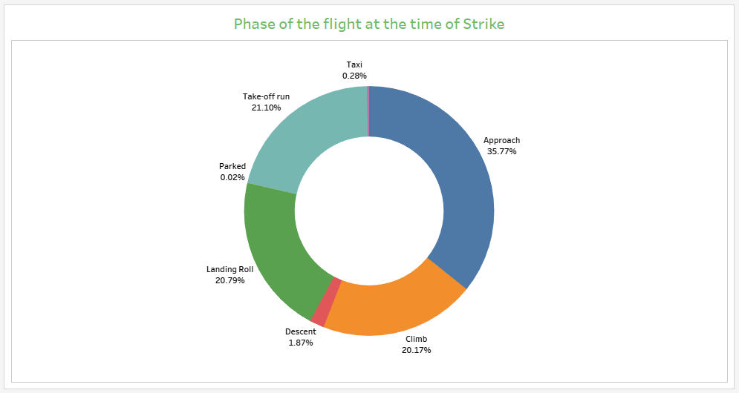
Phase of the flight at the time of Strike

Slide 9
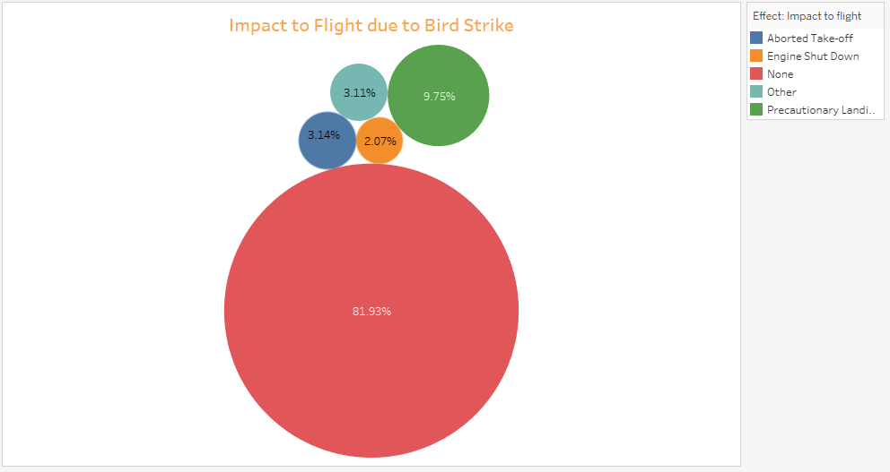
Impact to Flight due to Bird Strike

Slide 10
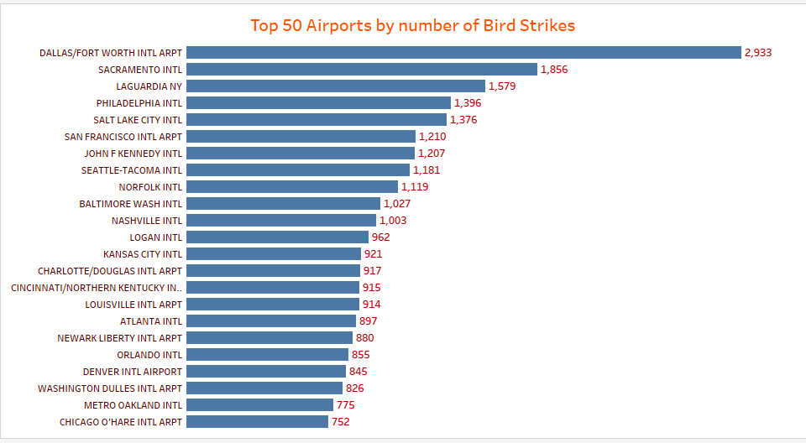
Top 50 Airports by number of Bird Strikes

Slide 11
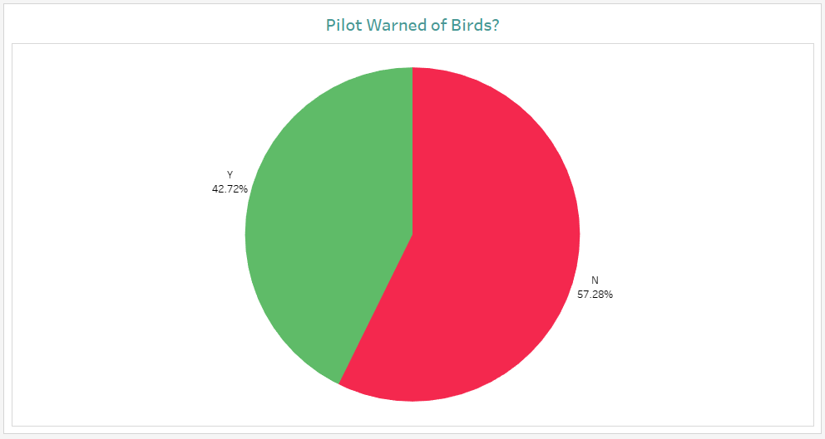
Pilot Warned of Birds?

Slide 12
Conclusion
42.72% incidents where pilot was warned about the birds
Prior warning to the pilot reduces the risk of damage to the aircraft
Highest cost($20.66M) incurred due to Canada Goose species of Bird
81.93% incidents had no impact while in 9.75% incidents, precautionary measures had been taken.
Bird Strikes Incidents have an upward trend and 2010 has the highest number of Bird Strike incidents. In 2001, Highest cost has been incurred due to Strike incidents
Most of the incidents have reported on DALLAS/FORT WORTH International Airport

